Slide 1
SNAPS: Real Time Outlier Detection
Jessica I. Maldonado Olivas
Northern Arizona University

Slide 2
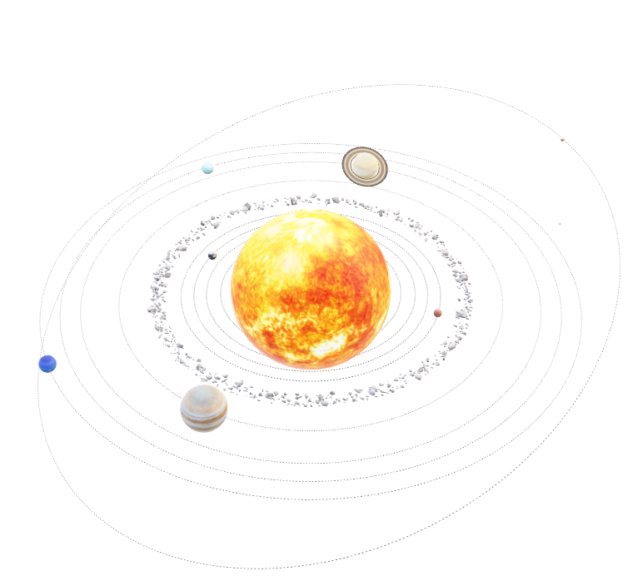
Overview
Introduction
SNAPS & Asteroids
Statistics & Computing
Compute Cluster
Plots

Slide 3
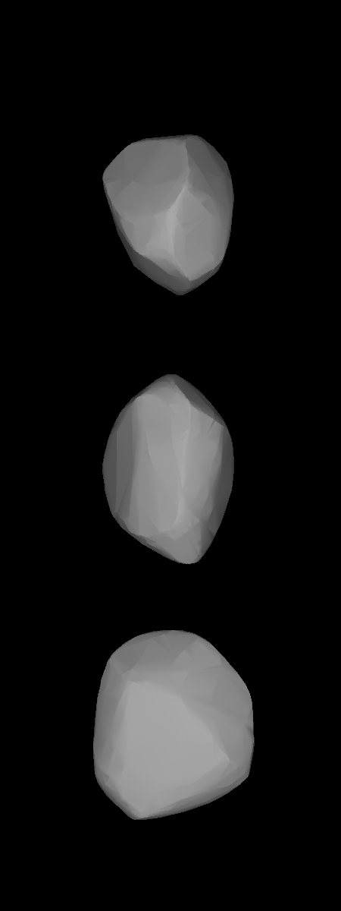
What is SNAPS?
The Solar System Notification Alert Processing System (SNAPS) processes information gathered from all-sky telescopic surveys in order to compile a comprehensive database of derived and measured asteroid properties.

Slide 4
Why Asteroids?
Asteroids are small, rocky bodies that are left over from the formation of the solar system that rotate around the sun
Asteroids are some of the oldest bodies in the solar system.
Their composition and varying physical properties allow for researchers to gain insight on the formation of the solar system

Slide 5
Outlier Detection
Utilizing techniques from computer science and statistics, we can identify asteroids with unusual properties that deviate from the norm.
Finding these unusual asteroids like active asteroids can help us better understand the diversity of small bodies in the solar system and the processes that have shaped them.

Slide 6
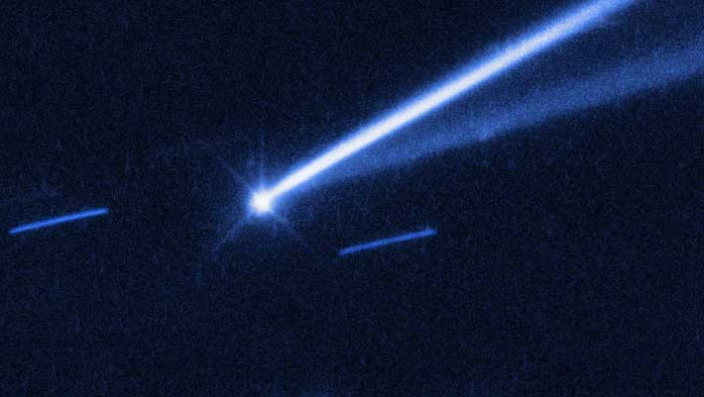
Object: 6478 Gault

Slide 7
Sky Surveys
Description & Importance

Slide 8
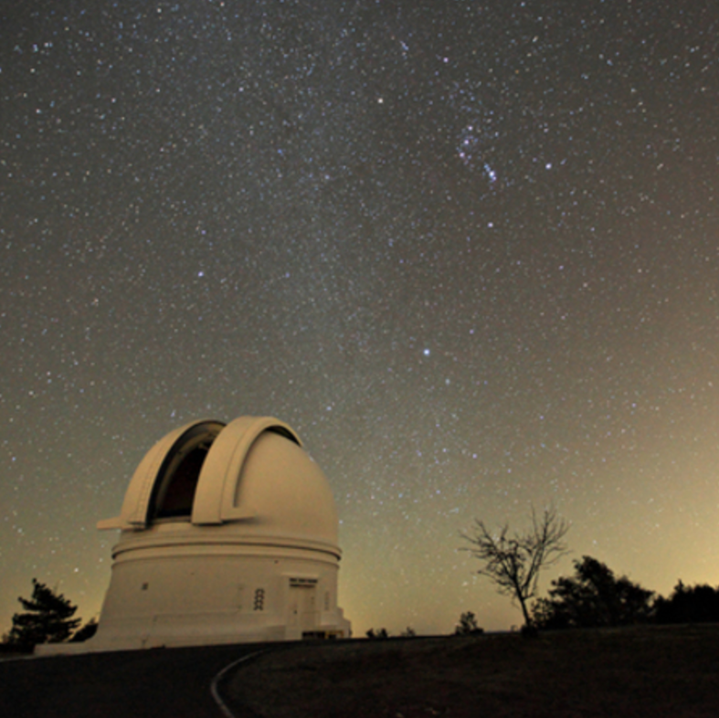
Zwicky Transient Facility
All-sky telescopic surveys provide observations conducted by telescopes which capture images of celestial bodies to their capable view
All-sky surveys are fundamental for the study of the because of the numerous amount of data they provide

Slide 9
Statistics & Computing
Process of Detecting Outliers
Using Jupyter Notebook & Python

Slide 10
Mongo DB Compass
The Database

Slide 11
Multiple Databases
Overall: 5,000,000 Observations
Worked with 32,000 Observations

Slide 12
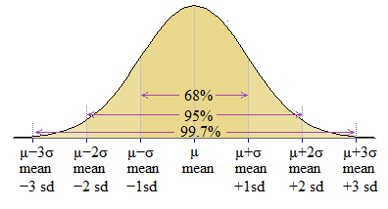
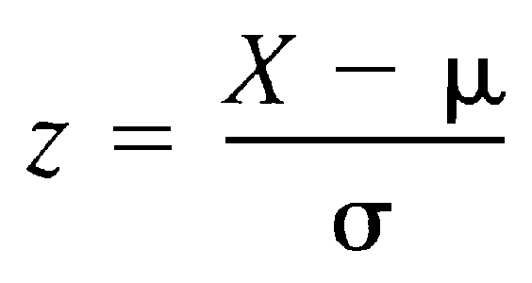
Outlier Calculations
The goal is looking specifically at data that has magnitude values three standard deviations from the mean.
Any data that greater than three standard deviations is considered an outlier and is pulled for further investigation

Slide 13
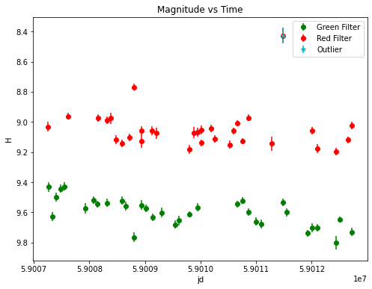

Slide 14
Computing Cluster
NAU’s Monsoon Computing Cluster

Slide 15
Data Processing
32,000 observations are a lot of data to look at on a local machine.
The use of a compute cluster allows us to process the data in minutes rather than a couple of hours.

Slide 16
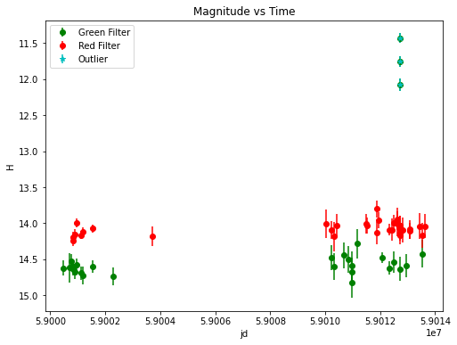
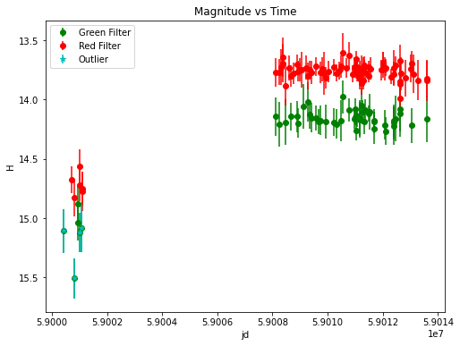
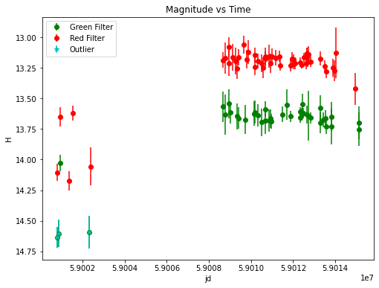
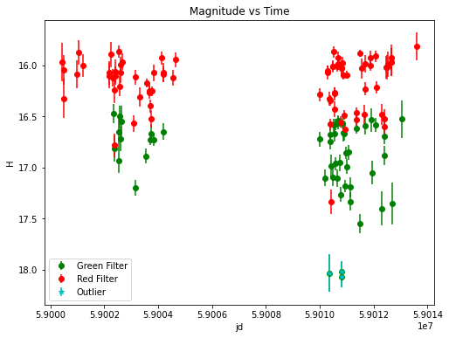
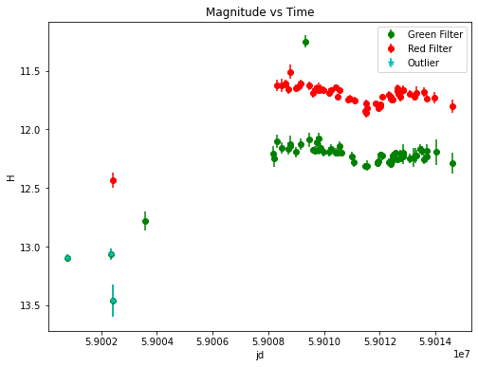

Slide 17
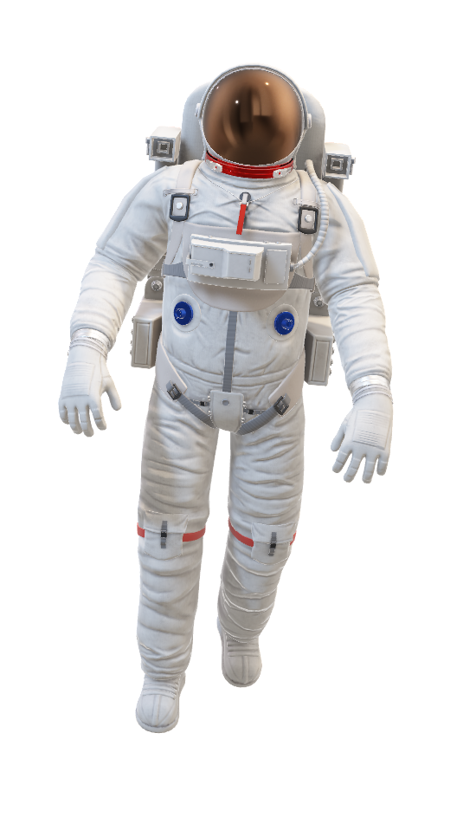
Acknowledgements
Dr. David Trilling
Dr. Micheal Gowanlock
Daniel Kramer
Maria Chernyavskaya

